Slide 1
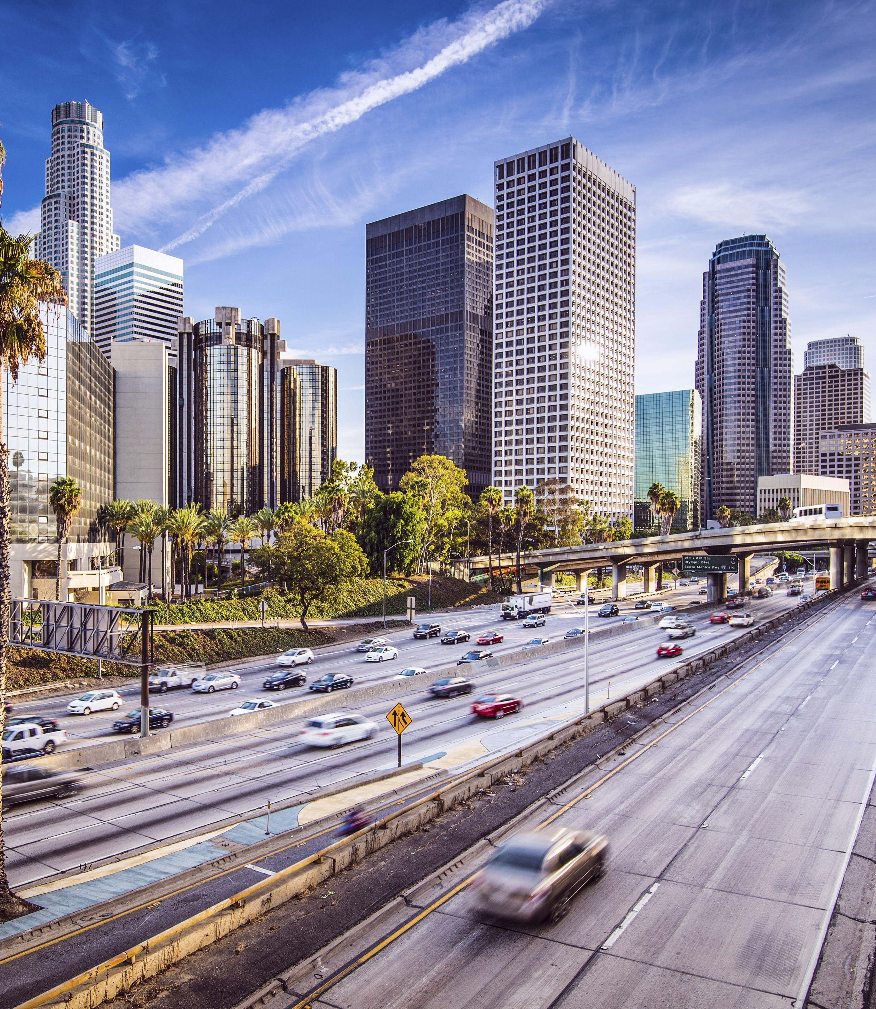


LOS ANGELES CITY - CRIME ANALYSIS AND STATUS PREDICTION Using Machine learning models
Sai Manasa Korumilli
DATA 606 Capstone Project
Dr. Chaojie Wang
9 NOV 2023

Slide 2
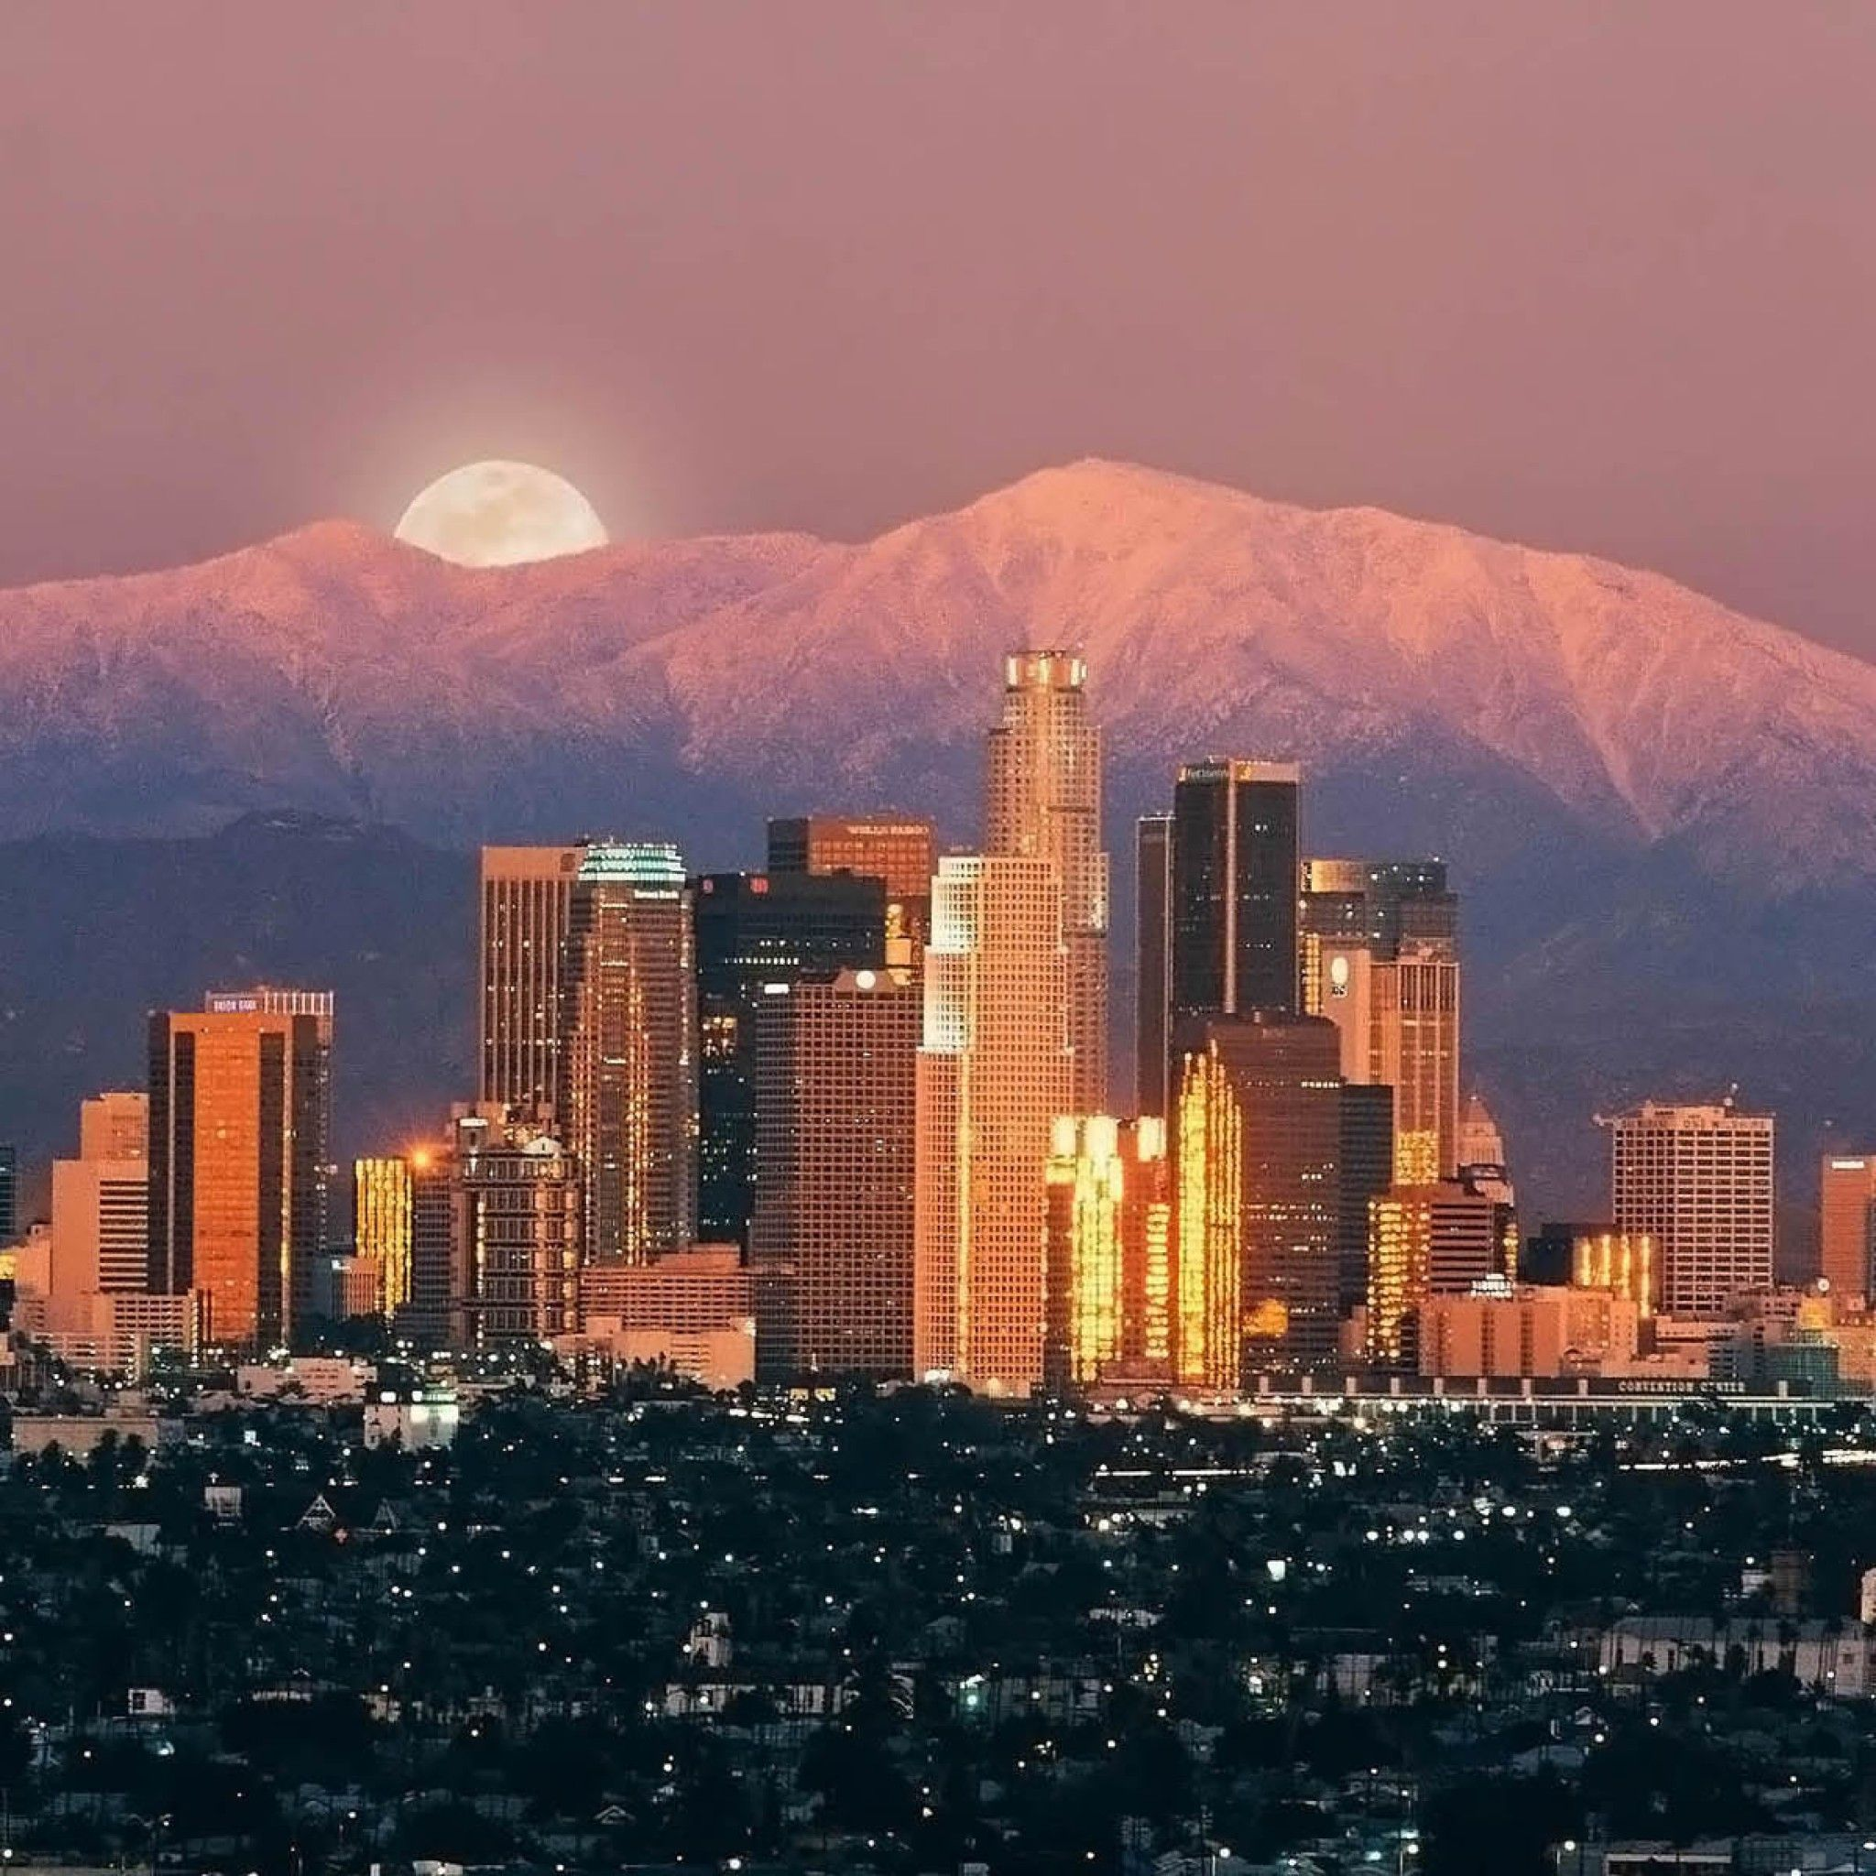




Content
Introduction
Data Source and Data Preprocessing
Exploratory Data Analysis
Machine Learning Models
Conclusion

Slide 3
Introduction
Los Angeles city in Southern California is a vibrant and diverse cultural hub, known for its rich tapestry of ethnicities, languages, and communities.
LA contributes a dynamic and a cultural landscape.
The city experiences a range of criminal activities, with particularly related to property crimes and gang-related incidents.
3

Slide 4

Over the years, crime rates have fluctuated, highlighting the complexity of urban safety.
This project captures a decade-long snapshot (2010-2019) of criminal incidents, providing valuable insights
To understand patterns and formulate effective strategies for crime prevention and response.
4

Slide 5

About the Data
The dataset contains crime records of Los Angeles city from 2010 – 2019
Source: Data is provided by the Los Angeles Police Department
Data Size: 515 MB
Data Shape: Number of rows: 2135598, Number of columns: 28
Each row represents a crime record
5

Slide 6
Data Dictionary
DR_NO | Division of Records Number
Date Rptd | Reported Date of Crime
DATE OCC | Crime Occurred Date
TIME OCC | Time Occurrence of Crime
AREA | Geographic Area Code 1-21
AREA NAME | Geographic Area Name
Rpt Dist No | A four-digit code that represents a sub-area within a Geographic Area
Premis Cd | The type of structure, vehicle, or location where the crime took place
Crm Cd | Indicates the crime committed
Crm Cd Desc | Defines the Crime Code provided
Mocodes | Activities associated with the suspect in the commission of the crime
Vict Age | Victim Age
Vict Sex | Gender of the Victim
Vict Descent | Descent of Victim ; Ex: A - Other Asian B - Black C – Chinese etc
Premis Desc | Defines the Premise Code provided

Slide 7
Weapon Used Cd | The type of weapon used in the crime
Weapon Desc | Defines the Weapon Used Code provided
Status | Status of the case
Status Desc | Defines the Status Code provided
Crm Cd 1 | Indicates the crime committed. Crime Code 1 is the primary and most serious one.
Crm Cd 2 | less serious than Crime Code 1
Crm Cd 3 | less serious than Crime Code 1,2
Crm Cd 4 | less serious than Crime Code 1,2,3
LOCATION | The street address of the crime incident rounded to the nearest hundred block to maintain anonymity
Cross Street | Cross Street of rounded Address
LAT | Latitude
LON | Longitude

Slide 8
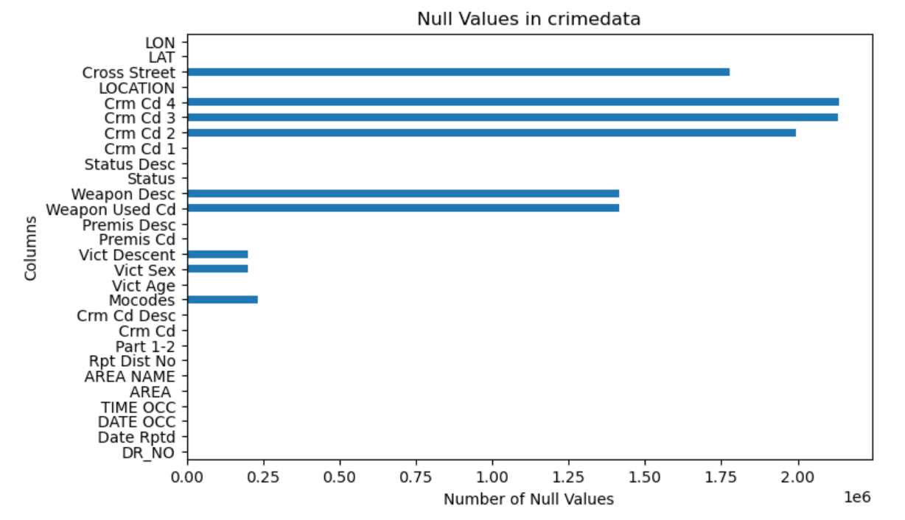
DATA PREPROCESSING
Removing the Duplicates - No duplicates present in the data
Removing the Similar Columns - Columns such as 'Mocodes', 'Crm Cd 1', 'Crm Cd 2', 'Crm Cd 3', 'Crm Cd 4', ' Part 1-2' represents similar information of 'Crm cd'. 'Rpt Dist No' and 'Cross street' are not of much necessary information
Replacing the null values - instead of dropping the rows of the null values which is crucial for ML, replaced them with 'Unknown' values.

Slide 9
EXPLORATORY DATA ANALYSIS
9

Slide 10
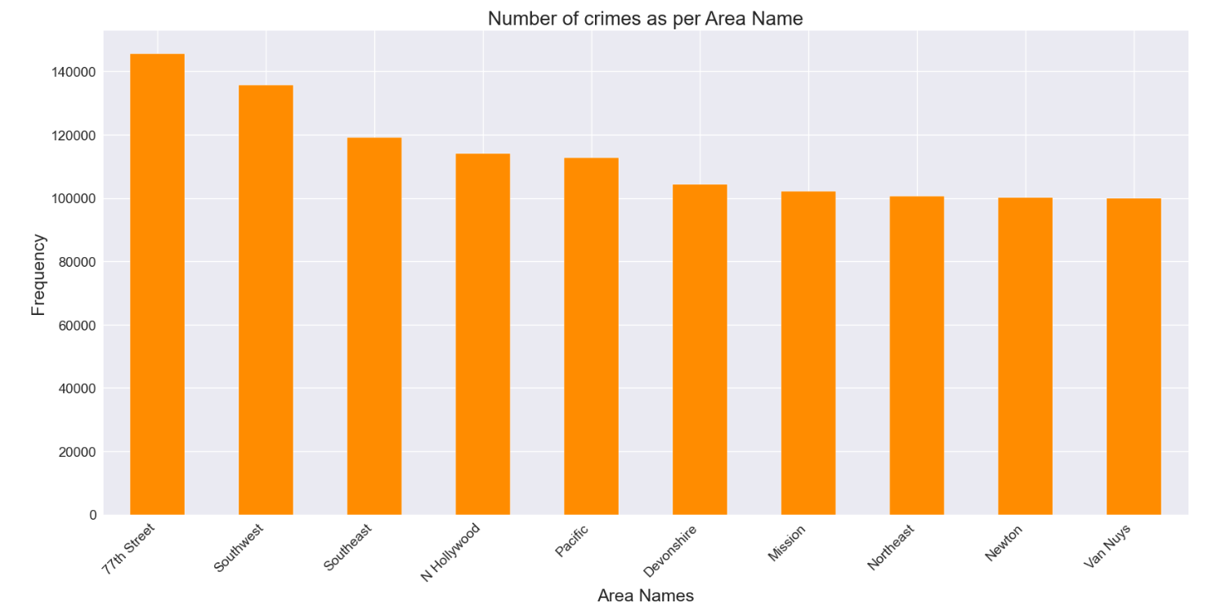
1. NUMBER OF CRIMES AS PER AREA NAME

Slide 11
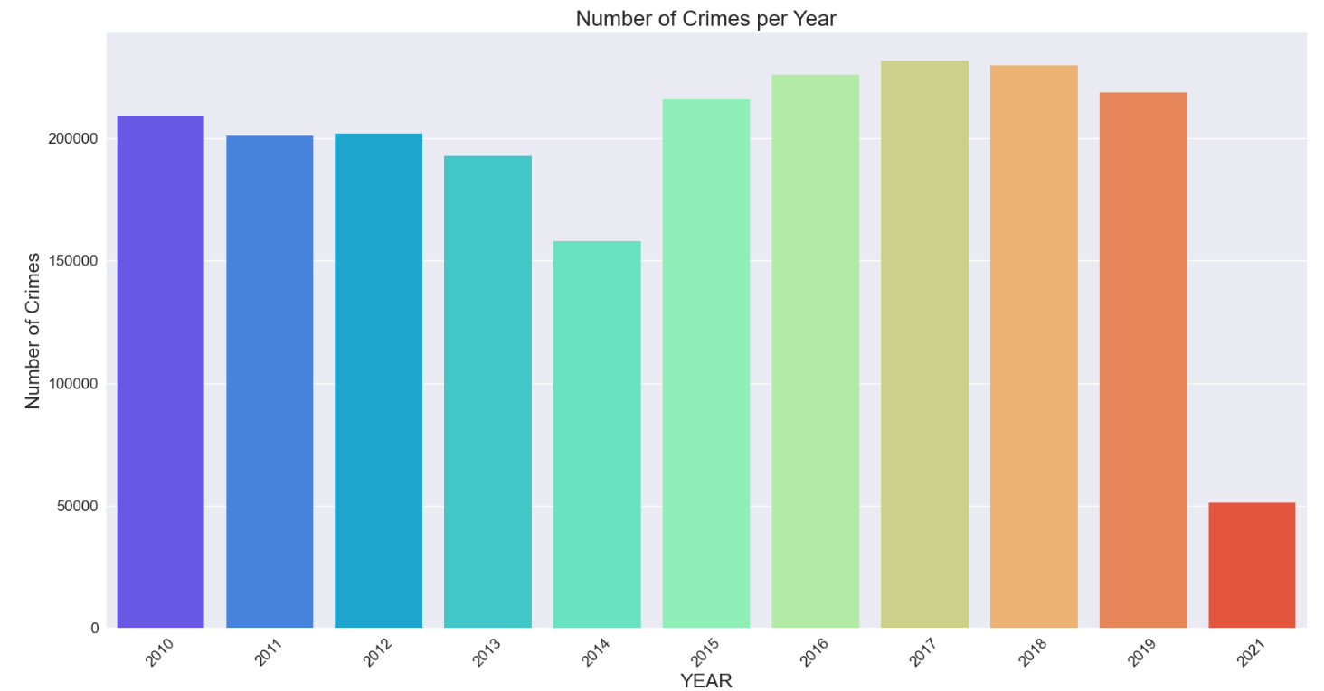
2. CRIMES PER YEAR

Slide 12
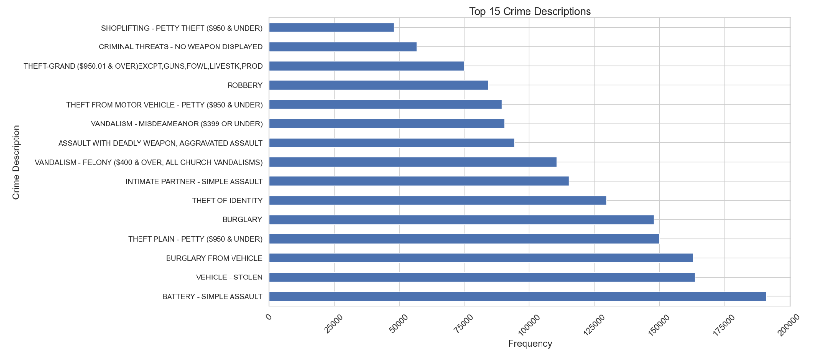
3. PRIME CRIME CATEGORIES

Slide 13
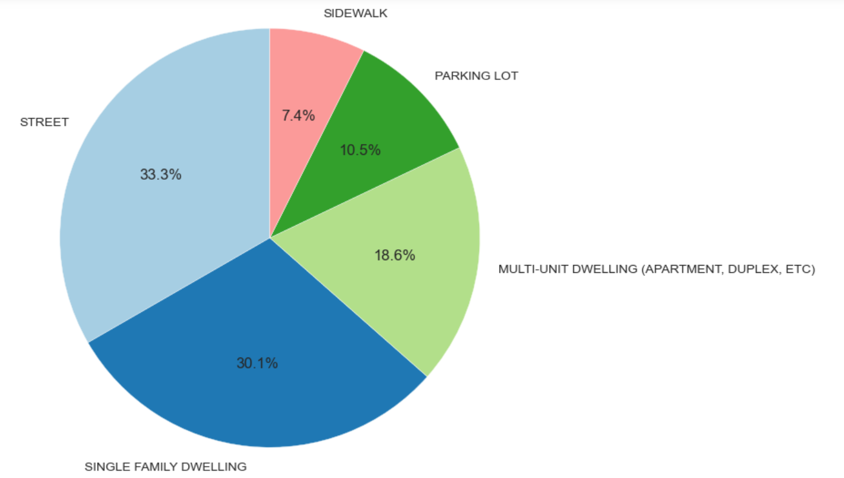
4. CRIMES AS PER PREMISES

Slide 14
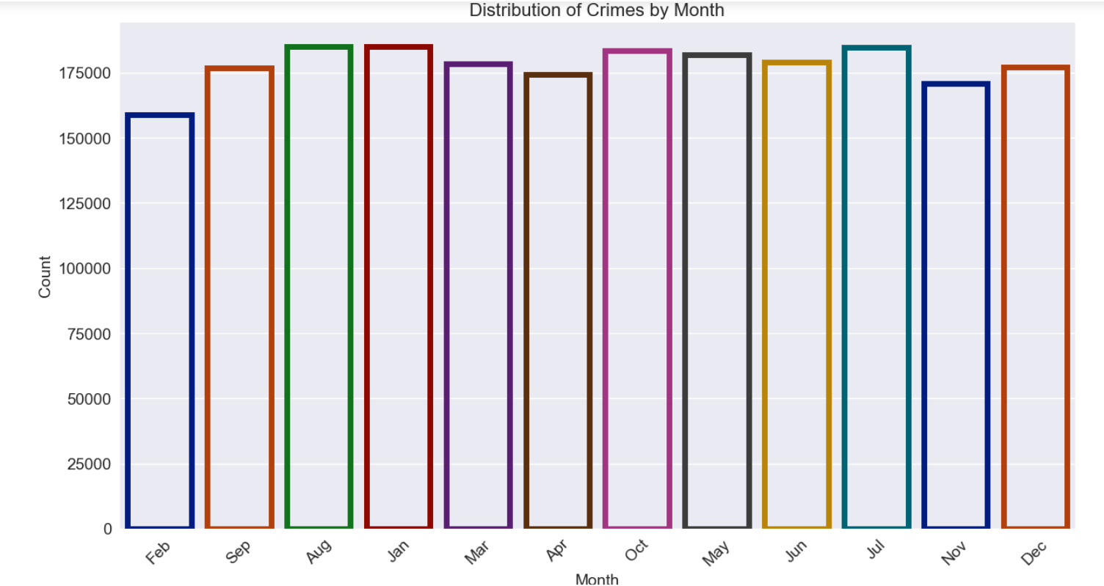
5. CRIMES AS PER MONTH

Slide 15
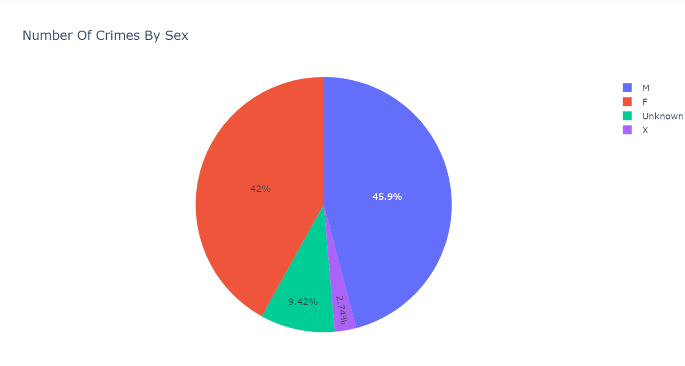
6. CRIME PERCENT BY GENDER
15

Slide 16
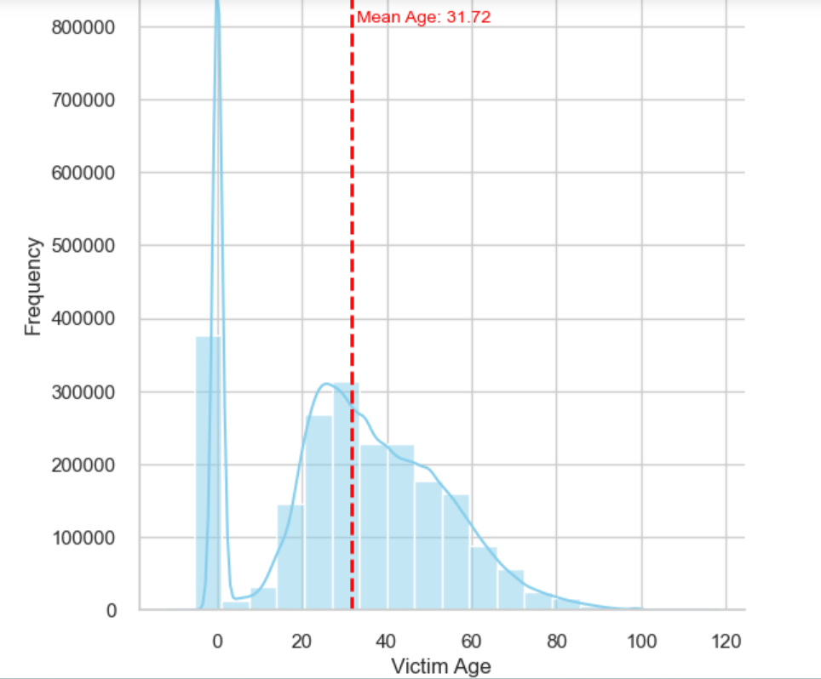
7. DISTRIBUTION OF VICTIM AGE

Slide 17
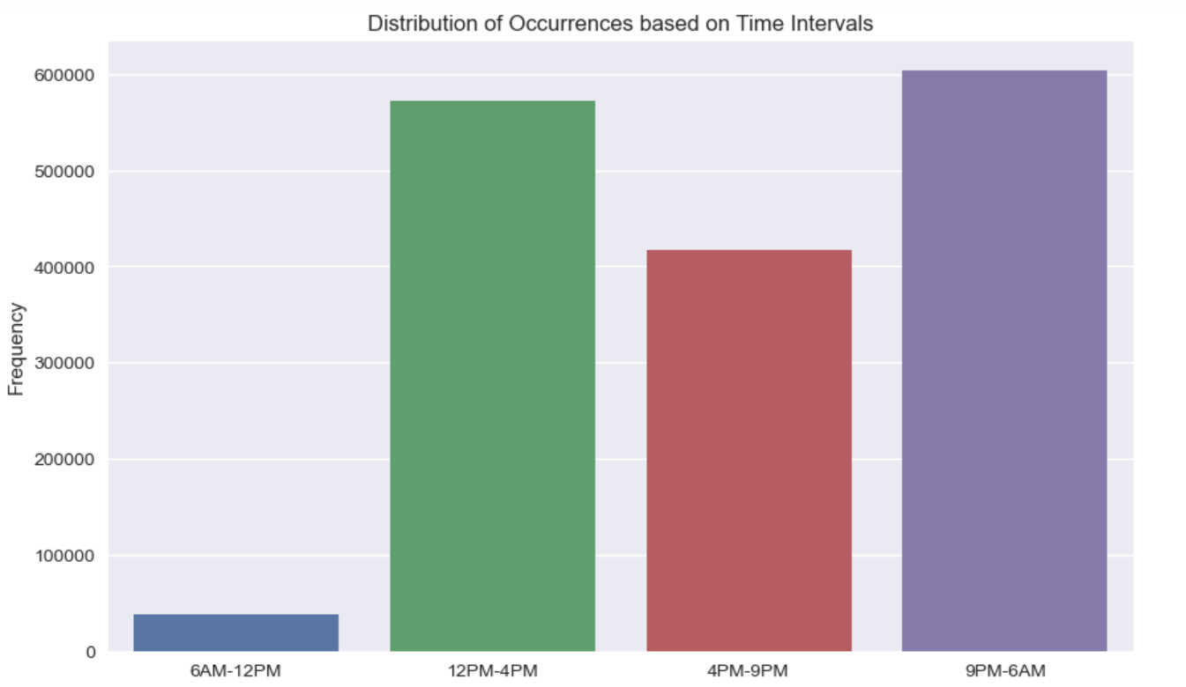
8. CRIMES AS PER TIME

Slide 18
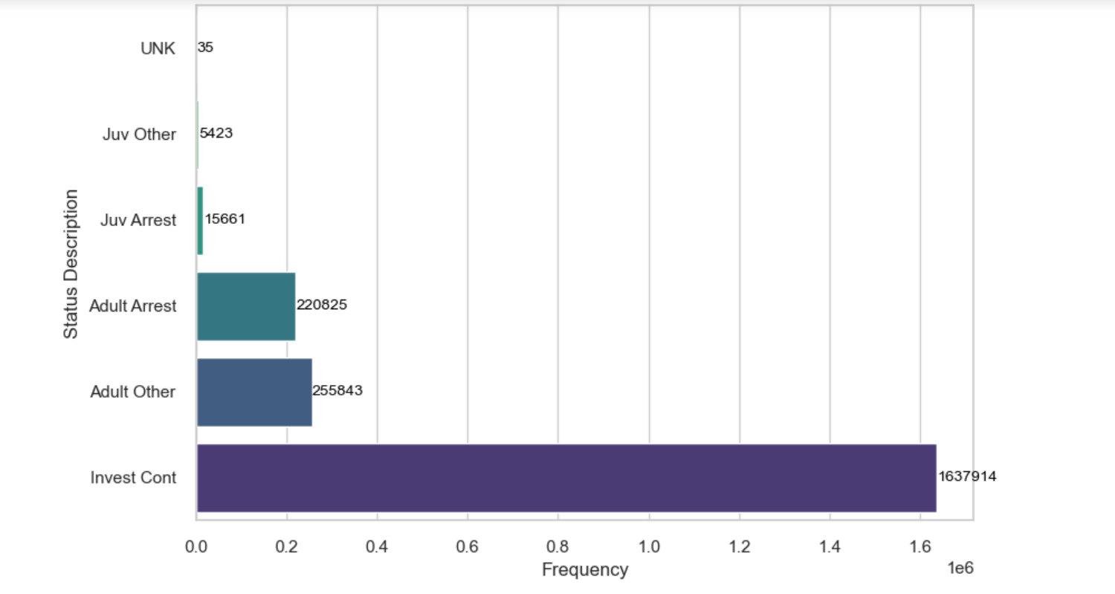
9. STATUS OF THE CRIMES

Slide 19
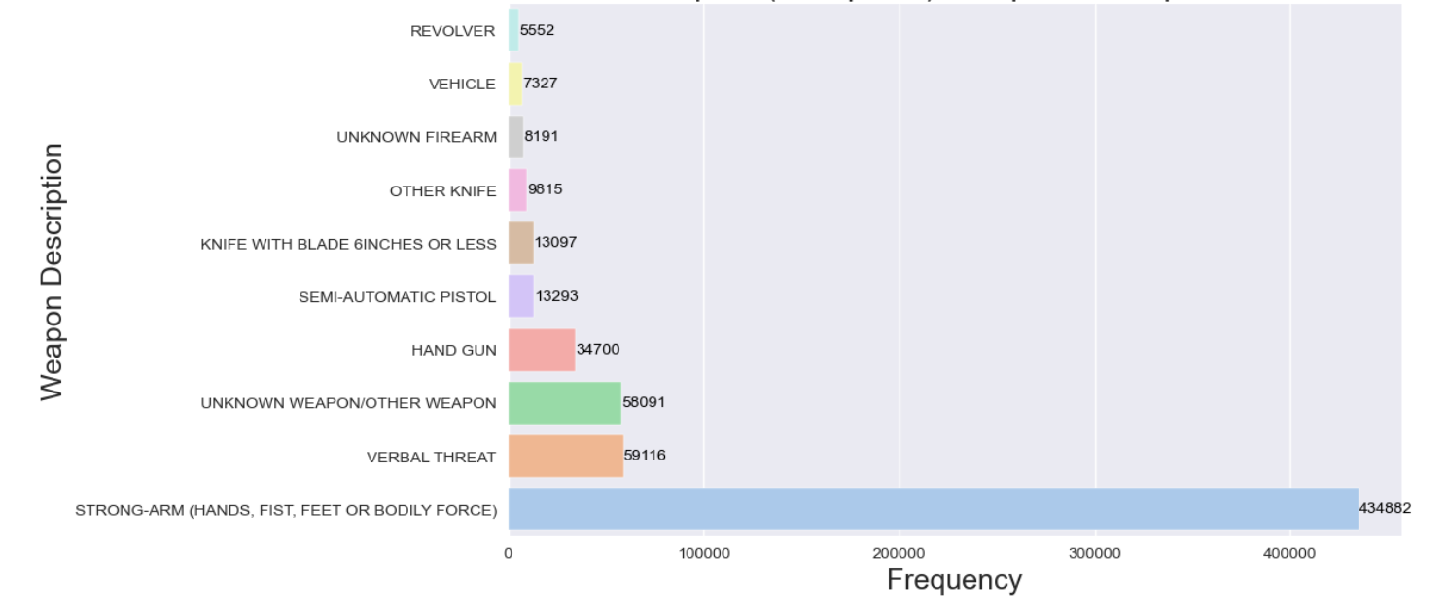
TOP WEAPONS USED IN THE CRIME

Slide 20
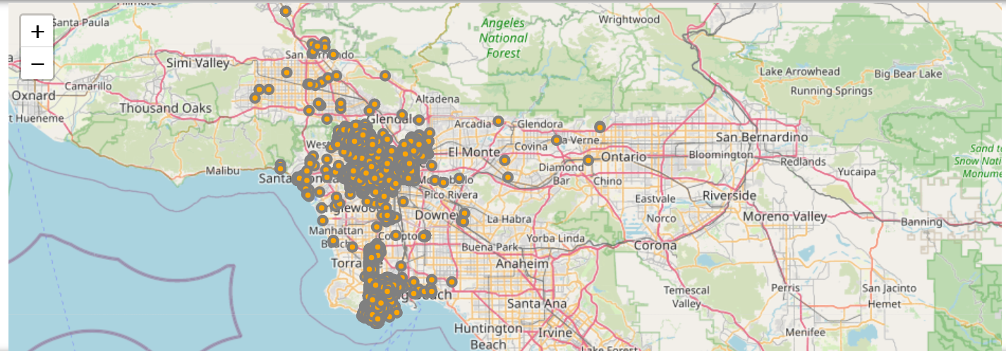
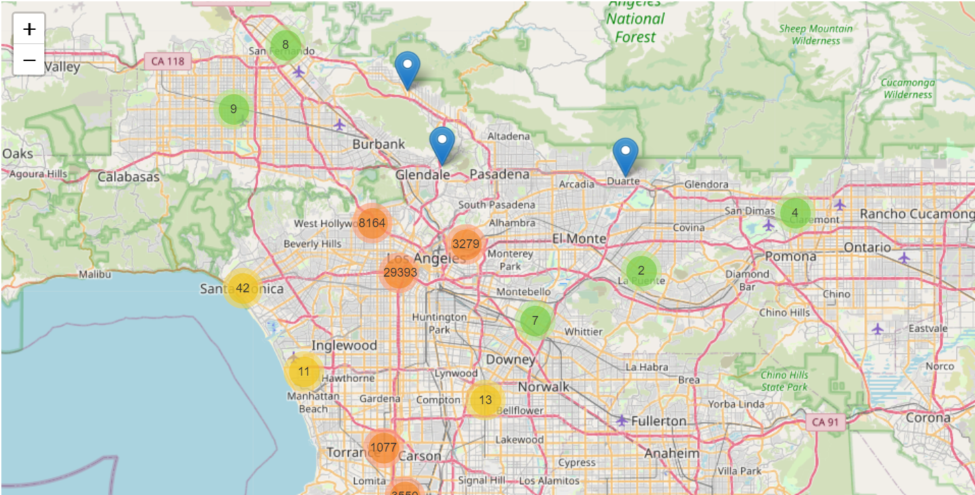
CRIMES AS PER LATITUDE AND LONGITUDE

Slide 21

MACHINE LEARNING MODELS

Slide 22
TARGET VARIABLE AND PREDICTORS
TARGET VARIABLE
FEATURES
STATUS DESC
VICT SEX
VICT AGE
VICT DESCENT
AREA NAME
WEAPON DESC
WEAPON USED
22

Slide 23
Classification Report
Machine Learning Model | Accuracy | Precision | Recall | F1 score
Logistic Regression | 0.82 | 0.83 | 0.76 | 0.79
Decision Tree | 0.89 | 0.86 | 0.92 | 0.89
Neural Network | 0.91 | 0.85 | 0.98 | 0.91
Random Forest Classifier | 0.90 | 0.87 | 0.93 | 0.90
Cat Boost | 0.88 | 0.87 | 0.87 | 0.87

Slide 24
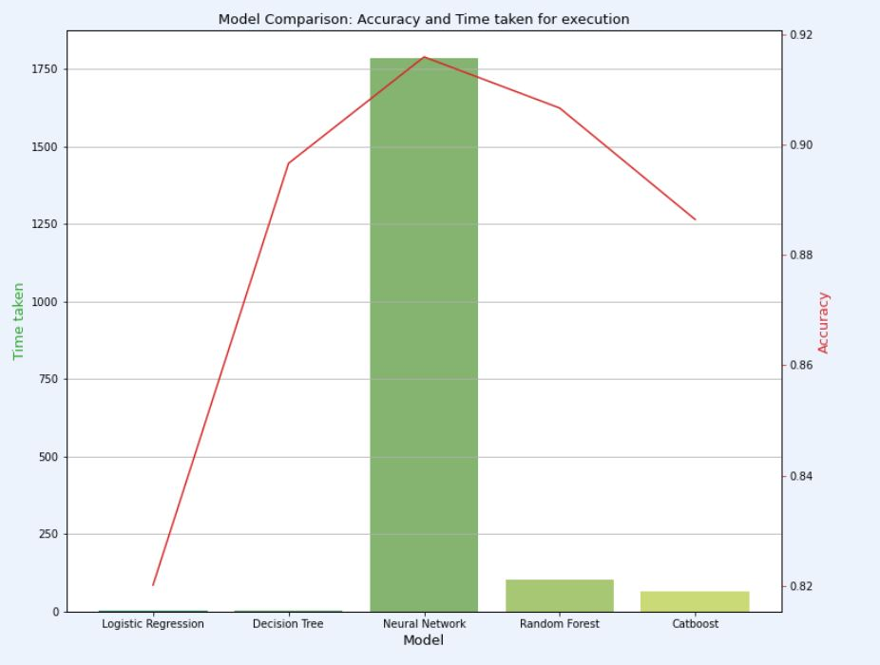
MODEL COMPARISION

Slide 25

Conclusion
Month-wise crimes - No major difference in the crimes
Crimes as per Area – 77th Street is prone to the crimes, deployment of more cops is required
Vehicle stolen, Burglary, battery assault are the major crimes, safety measures to be implemented
Streets and Parking lots are not safe, can impose few restrictions on parking
Most happening crimes are at night, should be cautious and call emergency incase of any suspicious activity
Male and youth are more prone to the crimes as per the analysis
In most cases, weapons used are bodily force, verbal threat and hand gun
In comparison to arrest or closing of the case, investigation is still continued.

Slide 26




Thank you
SAI MANASA KORUMILLI saimank1@umbc.edu

